Slide 1

Go Norquest
CMPT 3830
Md Mahbub Mishu
Notes:
Nav
Good evening everyone, Thanks for being here today.. We are truly honored to have such an esteemed audience, including our professors, industry professionals, and fellow students. Your presence means a lot to us, and we appreciate you taking the time to be here.
We are Team [Go Norquest], and we are excited to present the results of our Machine Learning Analyst project in collaboration with Go Auto. Our project focuses on analyzing car sales data to identify the best-selling geographical regions in Edmonton using clustering techniques.

Slide 2
Group Members
Dionathan Dos Santos ~ Model Developer
Mayank Khera ~ Data gathering and preparation (Scrum Master)
Navkirat Singh ~ Team Leader
Vinit Kataria ~ Result Interpreter and presenter
Notes:
Nav

Slide 3
Problem Statement and objectives
Identify what geographical regions in Edmonton are the best sellers.
Cluster regions by number of sales and total gross sale.
Consider creating a model for used cars and another one for new cars.
For visualization, generate necessary graphs, charts etc. in your dashboard.
Notes:
Nav
"Let me walk you through our problem statement and objectives for this project.
First, our goal is to identify which geographical regions in Edmonton perform the best in terms of car sales. This insight can help dealerships optimize their strategies and focus on high-performing areas.
To achieve this, we aim to cluster these regions based on the number of sales and total gross sales, providing a clear picture of sales distribution and patterns.
Additionally, we plan to create separate models for used cars and new cars. By doing this, we can cater to the unique characteristics and trends of these two markets, ensuring our analysis is both detailed and actionable.
Finally, we will visualize our findings using graphs and charts in a dashboard. These visualizations will make it easy to communicate key insights and support decision-making.
This structured approach will allow us to deliver a comprehensive understanding of car sales dynamics in Edmonton. Now, let’s dive deeper into the details."

Slide 4
Dataset Overview
Source:
Compiled by Go Auto's Business Intelligence Team
Used from Canadian Black Book(CBB)
Size:
Approximately 147,000 car listings
Contains 47 features per record
Key Features:
Vehicle details: Year, Make, Model, Mileage
Sales metrics: Sales region, Days on Market
Dealership data: Location, Revenue
Notes:
"This slide provides an overview of the Clustering Model we used in our project.
What is Clustering? Clustering is a method to group data points based on their similarities. For our project, we used it to uncover patterns and group dealerships or regions based on their performance and trends. It’s a powerful tool for identifying hidden structures within our data.
Model Used: We employed the K-Means Clustering algorithm. It's one of the most widely used clustering methods, known for its efficiency and simplicity. K-Means helps us identify natural groupings within the data, which is crucial for making informed business decisions.
Number of Clusters: Through our analysis, we identified 6 distinct clusters, each representing a unique region in Edmonton. These clusters provide insights into regional trends and help dealerships target their efforts effectively.
By leveraging clustering, we can break down complex data into manageable groups, making the results actionable and insightful for stakeholders."

Slide 5
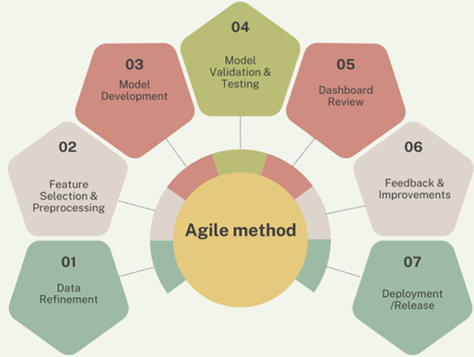
Management
Agile:
Agile to iteratively deliver project goals through sprints, incorporating regular SCRUM ceremonies to ensure alignment and continuous feedback​​.
Notion:
Notion to organize project tasks, track sprint progress, and collaborate efficiently by maintaining a centralized workspace for documentation, timelines, and updates, ensuring all team members stay aligned.

Slide 6
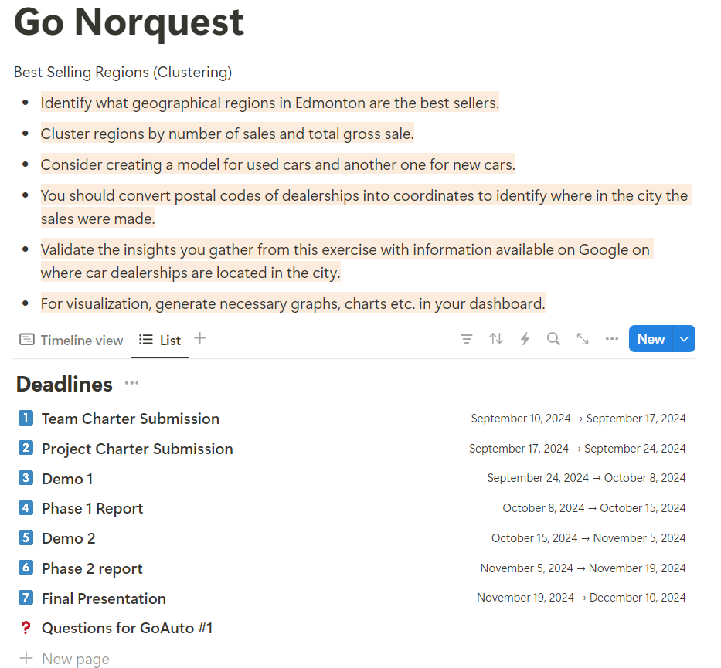
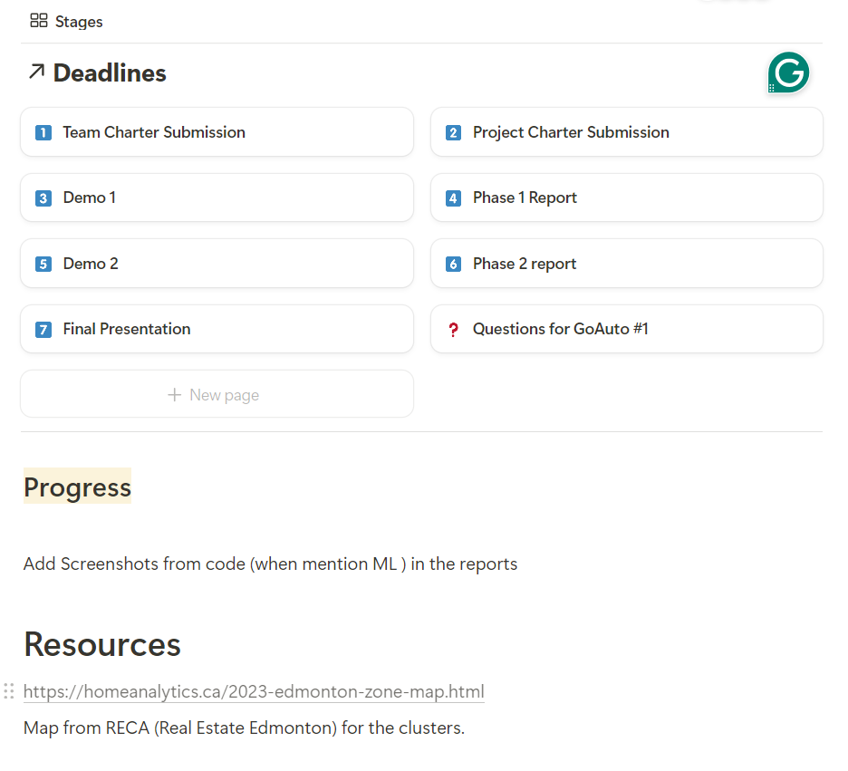
Notion
Notes:
Nav
"Now, let’s talk about how we managed our project tasks using Notion, a highly effective tool for organization and collaboration.
Project Overview: The Notion workspace served as a central hub for our project. We detailed our objectives, such as identifying top-performing regions in Edmonton and creating clustering models. The workspace also highlighted additional steps, like converting dealership postal codes into coordinates and validating insights using external data sources.
Deadlines: To ensure timely progress, we established clear deadlines for key milestones:
The Team Charter and Project Charter submissions set the groundwork.
Demo presentations and phase reports tracked our ongoing progress.
All efforts culminated in this Final Presentation, which ties everything together.
Progress Tracking: We utilized the progress section to monitor tasks, such as integrating screenshots of our machine learning outputs and ensuring all deliverables were included in the reports.
Resources: For reference, we linked relevant external data sources, such as maps from RECA (Real Estate Edmonton), which supported our clustering insights.
Using Notion allowed us to stay organized, align our efforts as a team, and ensure no critical tasks were overlooked. It streamlined our workflow and helped us focus on achieving our project goals efficiently."

Slide 7
EDA Results
We performed EDA to clean, explore, and visualize the data, uncovering key patterns and trends to inform model development and business insights​​.

Slide 8
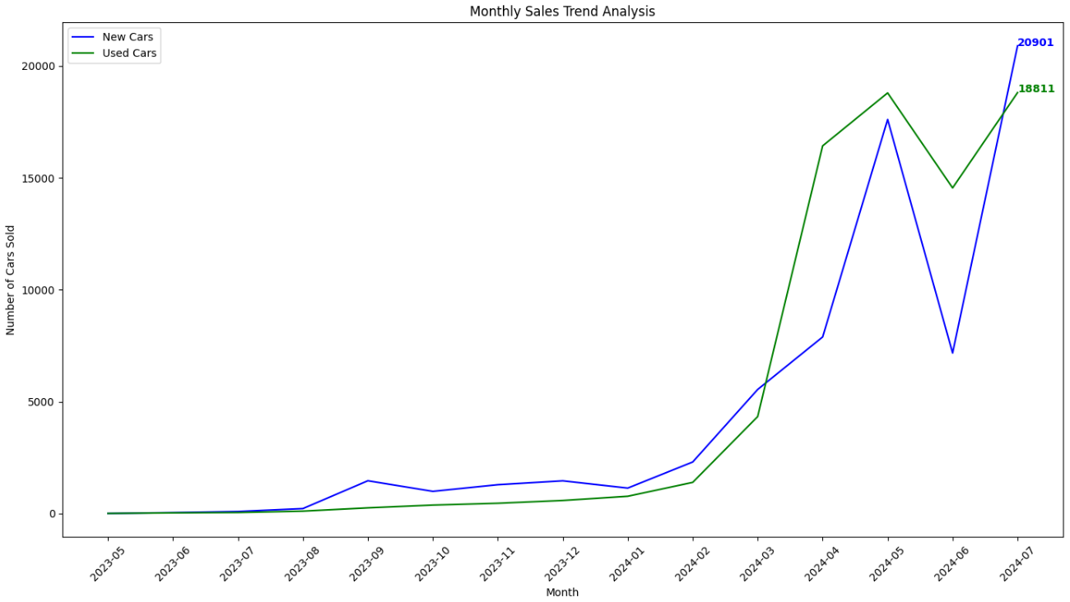
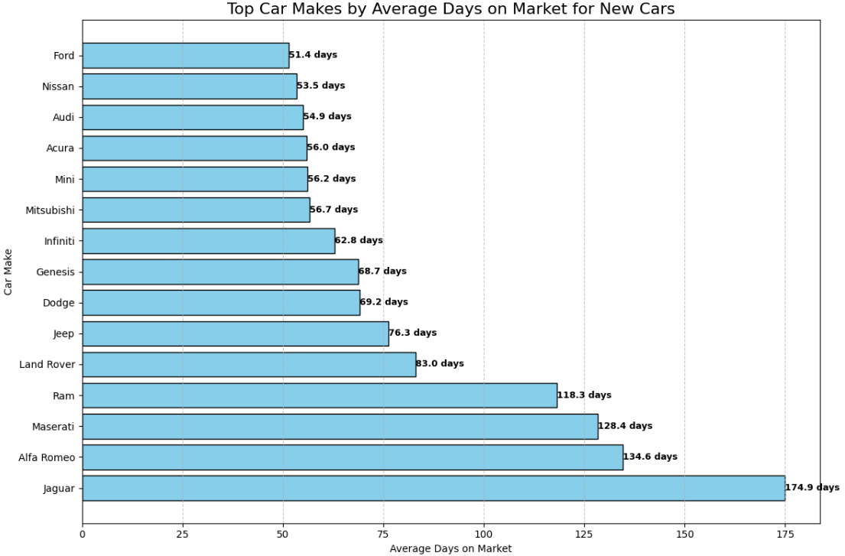
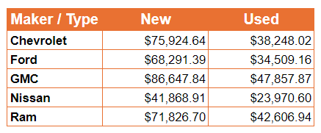
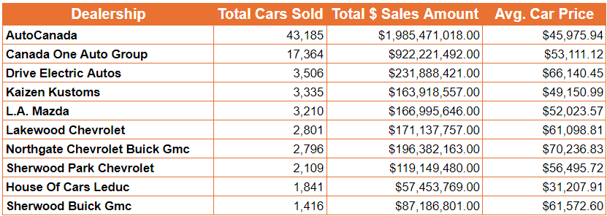
Notes:
dionathan

Slide 9
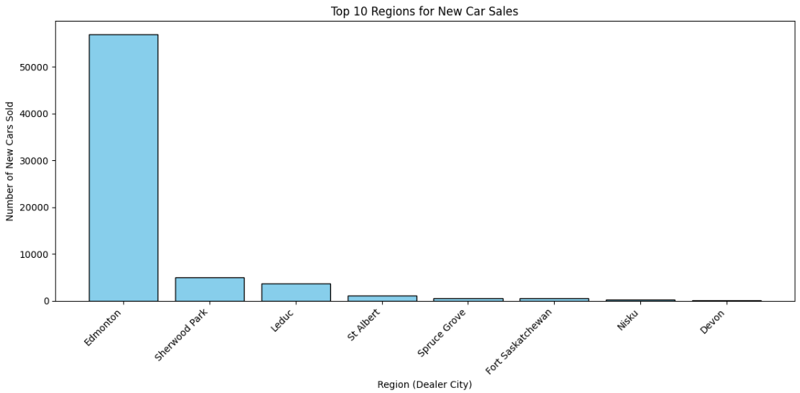
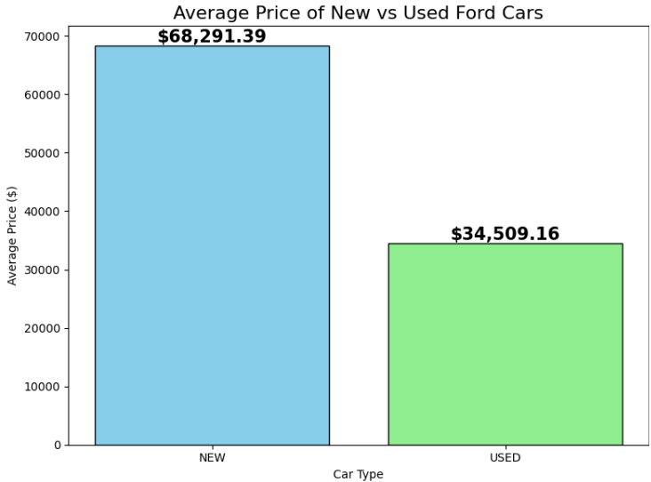
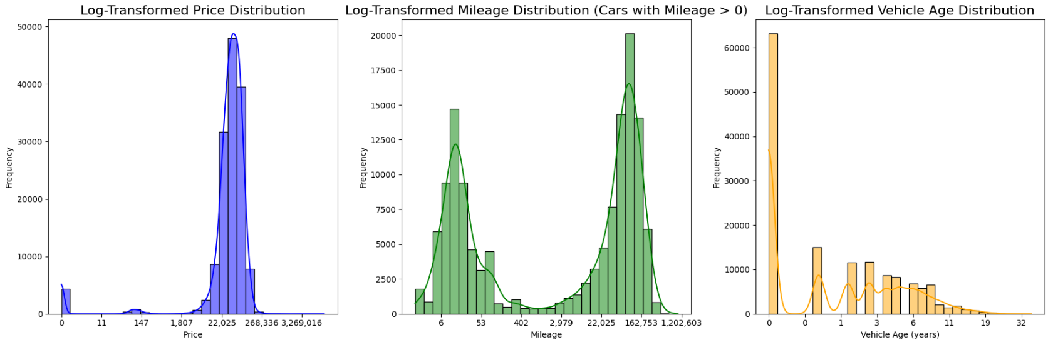
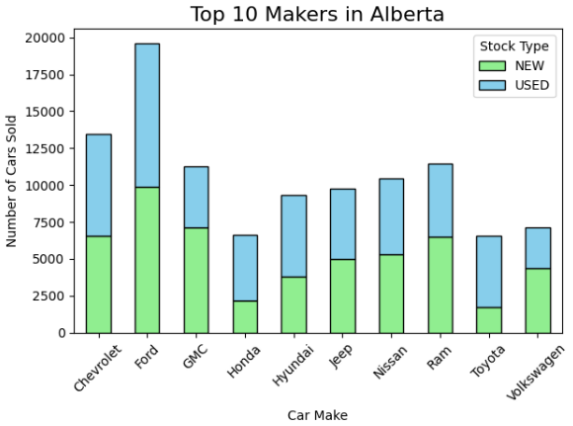
Notes:
dionathan

Slide 10
Handling Data
After EDA, we identified and handled duplicates by creating a composite key using relevant features, and we segmented the data into sub-regions based on postal codes for more granular analysis​​.

Slide 11
Clustering Model Overview
What is Clustering?
Clustering groups data point based on their similarities
Used to identify patterns or groups in data, such as dealership performance or regional trends
Model Used:
K-Means Clustering algorithm
Number of Clusters
6 clusters identified, representing different regions
Notes:
What is Clustering?
Clustering is a method of grouping data points based on their similarities.
For instance, by clustering dealerships in Edmonton, we can better understand which regions perform well and why.
To achieve this, we used the K-Means Clustering algorithm.This model is particularly effective for segmenting data into distinct groups based on key features like sales and revenue
After running our analysis, we identified six clusters.
These clusters represent different regions with distinct sales characteristics, providing a granular view of dealership performance.
Purpose of Clustering:
Clustering allows us to focus on regional sales trends, enabling Go Auto to tailor their strategies to specific areas.
It supports better resource allocation, targeted marketing, and informed decision-making.
Transition to the Next Slide:
"Now that we've introduced the clustering model, let’s look at the specific features and data we selected for our models."

Slide 12
Machine Learning Approach
Description of model:
Used K-Means for clustering
Objective: Group dealerships based on sales performance and revenue patterns
Input features included:
Gross Sales, Region, Postal codes, Model Popularity

Slide 13
We created 2 different Models
Different models target unique objectives, improving prediction accuracy.
Multiple models capture regional or demographic data patterns.
Specialized models deliver clearer, actionable insights for strategic use.
Notes:
Nav

Slide 14
Importance of feature selection
Definition
Process of selecting the most relevant features for the mod
Reduces noise, improves model accuracy, and decreases computation time
Key Features selected
Avg Milage, Avg Price, Drivetrain…
Benefits
Enhanced model performance by reducing irrelevant data
Prevents overfitting and ensures better generalization
Simplifies model interpretation

Slide 15
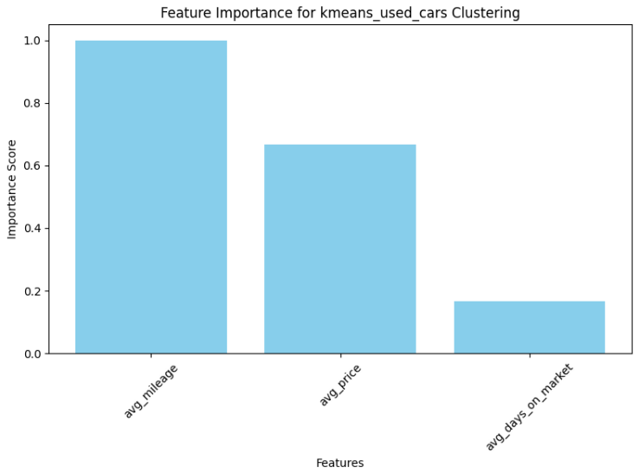
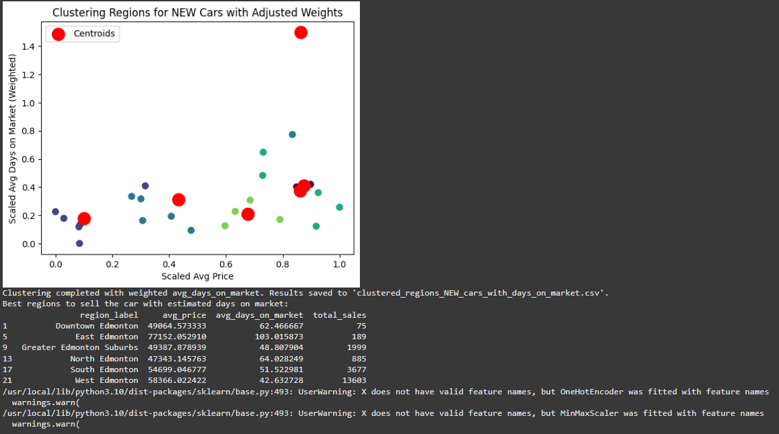
Feature Importance – New Cars Model

Slide 16
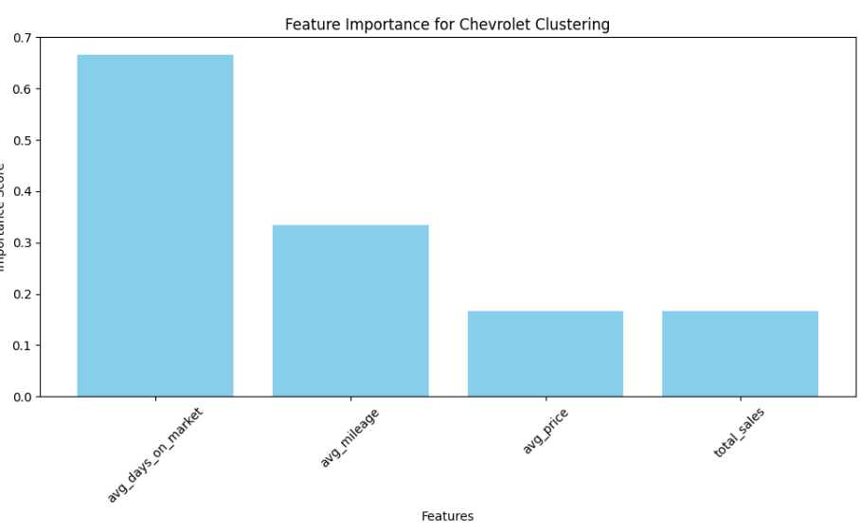
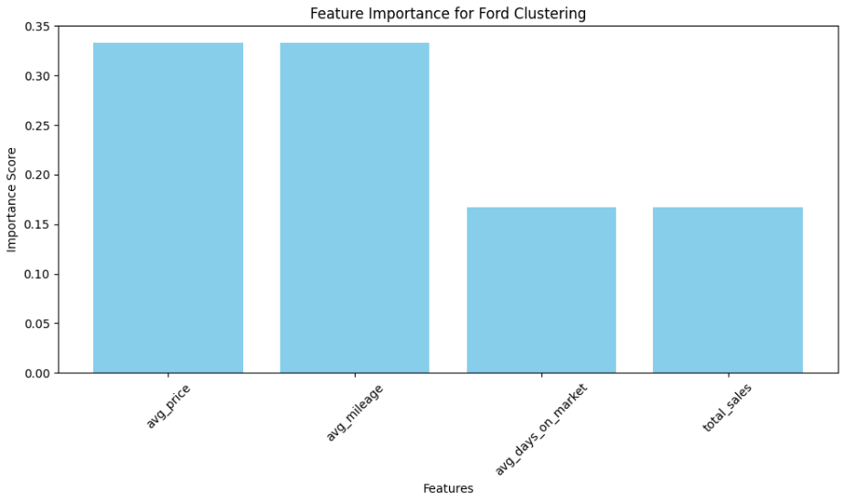
Feature Importance – Makers Model

Slide 17
Power BI Dashboard

Slide 18
App Development
Tool Used:
Streamlit, an open-source python library for building web apps
Why streamlit?
Easy to use and designed for data science applications
Enables real-time updates and interactive visualizations.
Suitable for non-technical users to interact with the data.
Advantages:
Integrates seamlessly with Python-based models.
Lightweight and requires minimal setup.
Who else uses
Popular among companies like Uber, Stripe and startups for quick prototyping and dashboarding
Notes:
Nav
For this project, we used Streamlit, an open-source Python library designed specifically for building web applications.
Streamlit allowed us to seamlessly integrate our data analysis and machine learning models into an interactive app.
While Notion is excellent for task management, documentation, and collaboration, it is not a tool designed for web app development.Notion is primarily used for organizing project workflows, tracking progress, and managing team collaboration.
We integrated GitHub with Streamlit to ensure version control and collaboration on our app development
Streamlit is popular among leading companies like Uber and Stripe, as well as startups, for its ability to support quick prototyping and dashboarding.

Slide 19
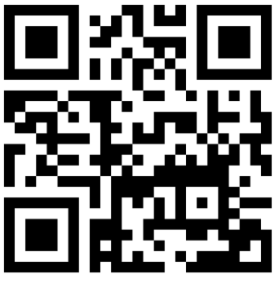
Link for the app and QR code
https://go-auto.streamlit.app/
Notes:
Nav

Slide 20
Thank You!
Notes:
Nav/ any more questions

